Slide 1
Sincerity
This is a summary of the Rollo on Sincerity given by Fr. Joseph G. Cascales at the 50th Anniversary of the First Cursillo Weekend held in Cala Figuera, on the Island of Mallorca, Spain in August 1944.

Slide 2
Webster Dictionary Definition of sincerity
: the quality or state of being sincere
: honesty of mind
: freedom from hypocrisy
Definition of sincere
1a: free of dissimulation : HONEST
b: free from adulteration : PURE
2: marked by genuineness : TRUE

Slide 3
Galileo, who could not convince the scientists with his calculations about the stars, constructed a telescope and when he had finished, he called the scientists and said: “Come, and with the telescope you will see what I have been telling you.”
The scientists said,” No, we are not going to look through your telescope because you might convince us.”

Slide 4
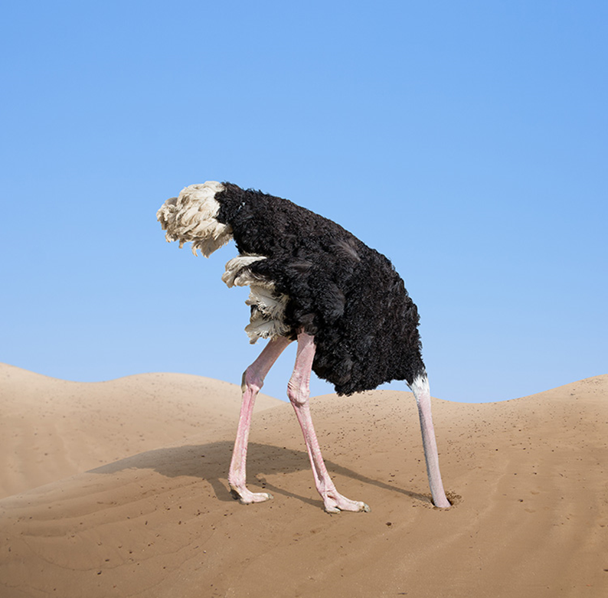
So often we’re like an ostrich – hiding our heads in the sand!

Slide 5
sincerity of conscience
sincerity and a life of faith
sincerity, veracity and foresight

Slide 6
The conscience is ultimate sincerity.
The conscience is the ultimate thing that exits.
The Vatican II Council said that the conscience is the sanctuary of God.
It is there, where man comes face to face with God.

Slide 7
The Church is governed like a dictatorship.
They are terribly afraid to allow freedom of conscience.

Slide 8
When man is true to himself, and if he is a believer, he knows that in ultimate sincerity is where he can, should and will find God.

Slide 9
We have to take great care in forming our conscience properly.
We should follow our conscience rather than instructions or suggestions from someone who is telling us what we should do.

Slide 10
What is the conscience?
The Bible calls the conscience, the heart. In the Old Testament, the heart was seen as being in the center of the person.
The Bible mentions the heart almost 1,000 times. In essence, it says: the heart is that spiritual part of us where our emotions and desires dwell.

Slide 11
Our conscience must be educated if it is to be the core strength within us.
We must educate our conscience with sincerity.

Slide 12
Our sincerity commits us to question ourselves without ceasing.
Are our Cursillos heading the right way?
Could our Cursillos be better?
Is our faith going the right way?
Could our faith be better?

Slide 13
“We practice honesty with others and ourselves, by being honest. We cannot play with a lie nor can we play with masks.”
- Furger

Slide 14
We should constantly ask ourselves are we really in the truth?
Are we being narrow-minded?
Are we being judgmental?

Slide 15
To question oneself and to discern, also requires sincerity of conscience.
The best way to discern the fruits of the Holy Spirit is to start with the first fruit, agape love, Christian love, love of the Gospel.

Slide 16
Is the God that we proclaim a God of kindness?
Our God is not a cruel God, a tyrant God. He is a God of tender love.
Many Catholics live in fear of God. We are afraid of God.
We should proclaim a God who is kind, who is tender, who is understanding and is also happiness (or joy.)
Cursillo transmits the message of the Gospel with joy.

Slide 17
Cursillo wants to announce the true God, the true Christ, the true Gospel and the true Church.
The Church is the Eucharistic community of love.

Slide 18
Sincerity and a life of faith go together.
What is faith?
Evaporation of faith

Slide 19
Sincerity is simply having one’s eyes open without taking them off reality.
This requires courage and bravery.
This also requires confidence in reality. We must accept our realities as they are.
We must find peace within the realities that we cannot change.

Slide 20
We need to know how to dream.
How many dreams of community, of friendship, of help, of solidarity, we would have to have, so that man can live his redemption?

Slide 21
“If you Christians would come to us with the spirit of Christ, no one could resist you.”
- Ghandi
Are we Christians authentic? Do we have the courage to be completely Christian?
Sincerity is the search for truth, sincerity is the cult of truthfulness, sincerity is the kingdom of the truth and Christ says: “The truth will set you free.”

Slide 22
We want to change the environments.
First we have to know the environment, but bravely, not only piously, but simply with the Spirit of Christ.

Slide 23
Proverbs 29:18 says “Without a vision (prophets) the people lose restraint.”

Slide 24
Sincerity is the greatest guarantee of our group reunions.
Christ said, “I do not call you servants, I call you friends.” The kingdom of God is a kingdom of friends.
This is why in Cursillo we want to make friends with all so that we all may make friends with Christ.

